Slide 1

Tree and The Boy
M.Abubakar 2025-CS-254

Slide 2


`
A long time ago , there was a huge apple tree
A little boy loved to come and play around it

Slide 3
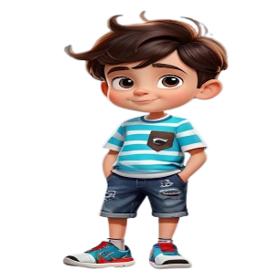
`
He climbed to the treetop , ate apples and took
a nap under the tree shadow

Slide 4
`
He loved the tree and tree loved to play with him

Slide 5
`
Time went by, the little boy had grown up and he
no longer played around the tree everyday.

Slide 6
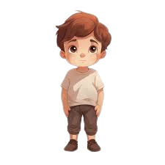
`
Come and play with me. The tree asked the boy.
I am no longer a kid I don’t play around trees anymore.
One day the boy came back to the tree and he looked sad

Slide 7
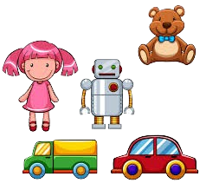
`
I want money to buy toys
Don’t worry pick all my apples and sale them then you have money

Slide 8


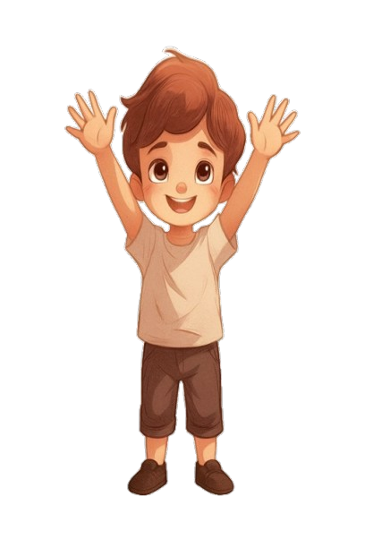
`
The boy was excited he grabbed all the apples on the tree
and left happily.
The boy never came back after he picked the apples,
tree was sad

Slide 9
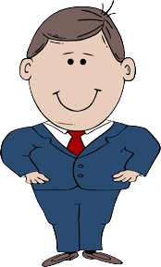

`
One day, the boy who now turned into a man
Returned and the tree was excited.

Slide 10
`
“Come and play with me”, the tree said.
I don’t have time to play with you I want to build a house
For my family .Can you help me?

Slide 11
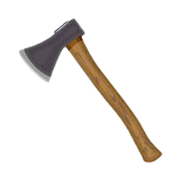
`
The man cut all the branches and left happily.
OK . Chop off my branches to build your house.

Slide 12

`
Tree was glad to see him happy but the man never came
back since then.

Slide 13
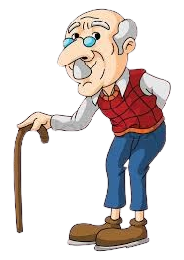
`
Finally after many years the man returned.
“Sorry my boy because I have nothing for you no
more apples no more bushes for you ” , tree said.

Slide 14
`
“Now, I only need some place for rest I am tired
After all these years” man replied.
The man sat down near the tree and tree was very glad and smiled with tears.

Slide 15


We don’t appreciate all they do for us until its too late
This is a story of everyone . The tree is like our parents.
When we are young we loved to play with our mom and dad.
May God forgive us for our shortcomings
and may he guide us.
No matter what parents will always be there and give
everything they could just to make you happy
When we grow up we leave them and we only come to them when we are in some trouble.

Slide 16
Moral:
“Always respect and care for those who care for you –
Before its too late”

Slide 17

THE END

